Slide 1


Basic Details of the Team and Problem Statement
Ministry of housing and Urban affairs
PS Code: SIH1516
Problem Statement Title: AI-POWERED MULTI-DEPARTMENT CITIZEN GRIEVANCE LODGING AND TRACKING SYSTEM FOR SEAMLESS EXPERIENCE
Team Name: NAYAK
Team Leader Name : AADARSH SONI
Institute Code (AISHE): C-25195
Institute Name: TECHNO INDIA NJR COLLEGE OF TECHNOLOGY
Theme Name: SMART AUTOMATION

Slide 2




Idea/Approach Details
TECHNOLOGY STACK:
FUTURE ASPECTS:
Appeal Mechanism: In the future, users dissatisfied with grievance resolution will have the option to appeal their complaints, ensuring a fair and transparent process.
Mobile Application Expansion: The web-app will evolve into a mobile application, offering enhanced convenience and accessibility for users on the go.
AI-Bot for Departments: We will introduce AI-powered assistance for government departments, further streamlining grievance handling and response times.
Central-Level Integration: The project will be upgraded for use at the central level, facilitating broader implementation and more extensive service coverage.
Multi-Platform Submission: We will support grievance submission through various platforms, including emails and phone calls, to accommodate diverse user preferences and needs.
Our solution is a comprehensive mobile application that streamlines the complaint reporting and tracking process.
Here's how it works
Intuitive NLP Interface: The app offers an intuitive Natural Language Processing (NLP) interface for easy complaint submission.
Complaint Form: Users describe grievances via a simplified NLP-enabled digital form.
AI-Driven Department Identification: An AI-powered Natural Language Understanding (NLU) chatbot analyzes descriptions and identifies the relevant department.
Effortless Multilingual Submission: Users can effortlessly submit complaints by dictating them in their local language, which is processed using Natural Language Processing (NLP) and Natural Language Understanding (NLU) technologies.
Seamless Submission: Complaints are seamlessly submitted to the identified department using NLP and NLU.
Unique Complaint ID: After submission, users receive a unique Complaint ID for tracking.
Real-Time Tracking: Users monitor complaint status with real-time updates and notifications.

Slide 3
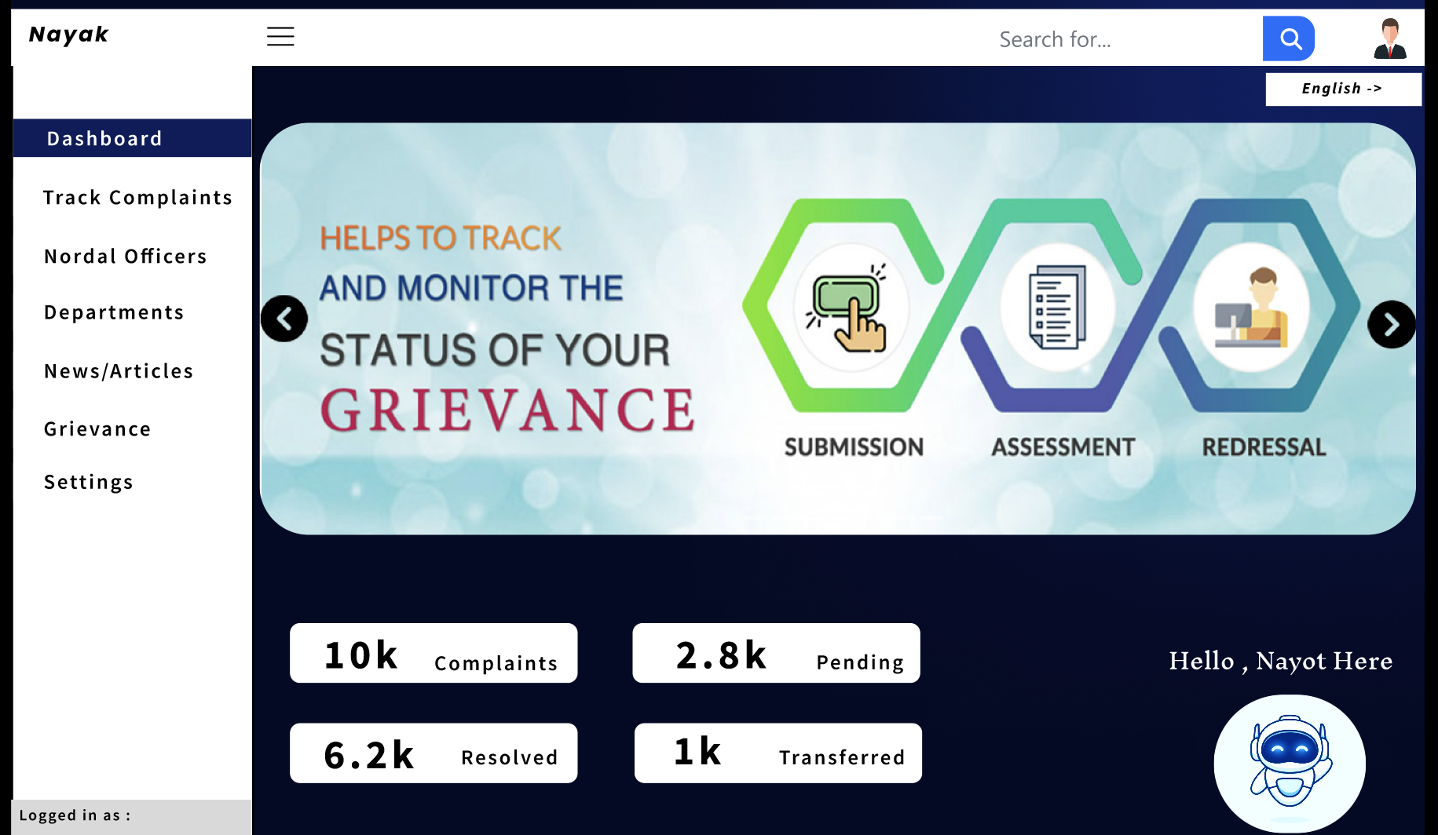
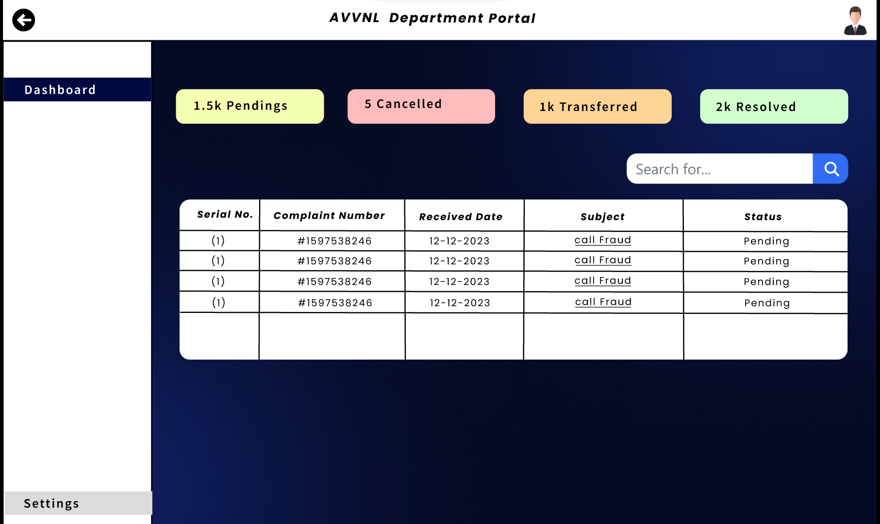
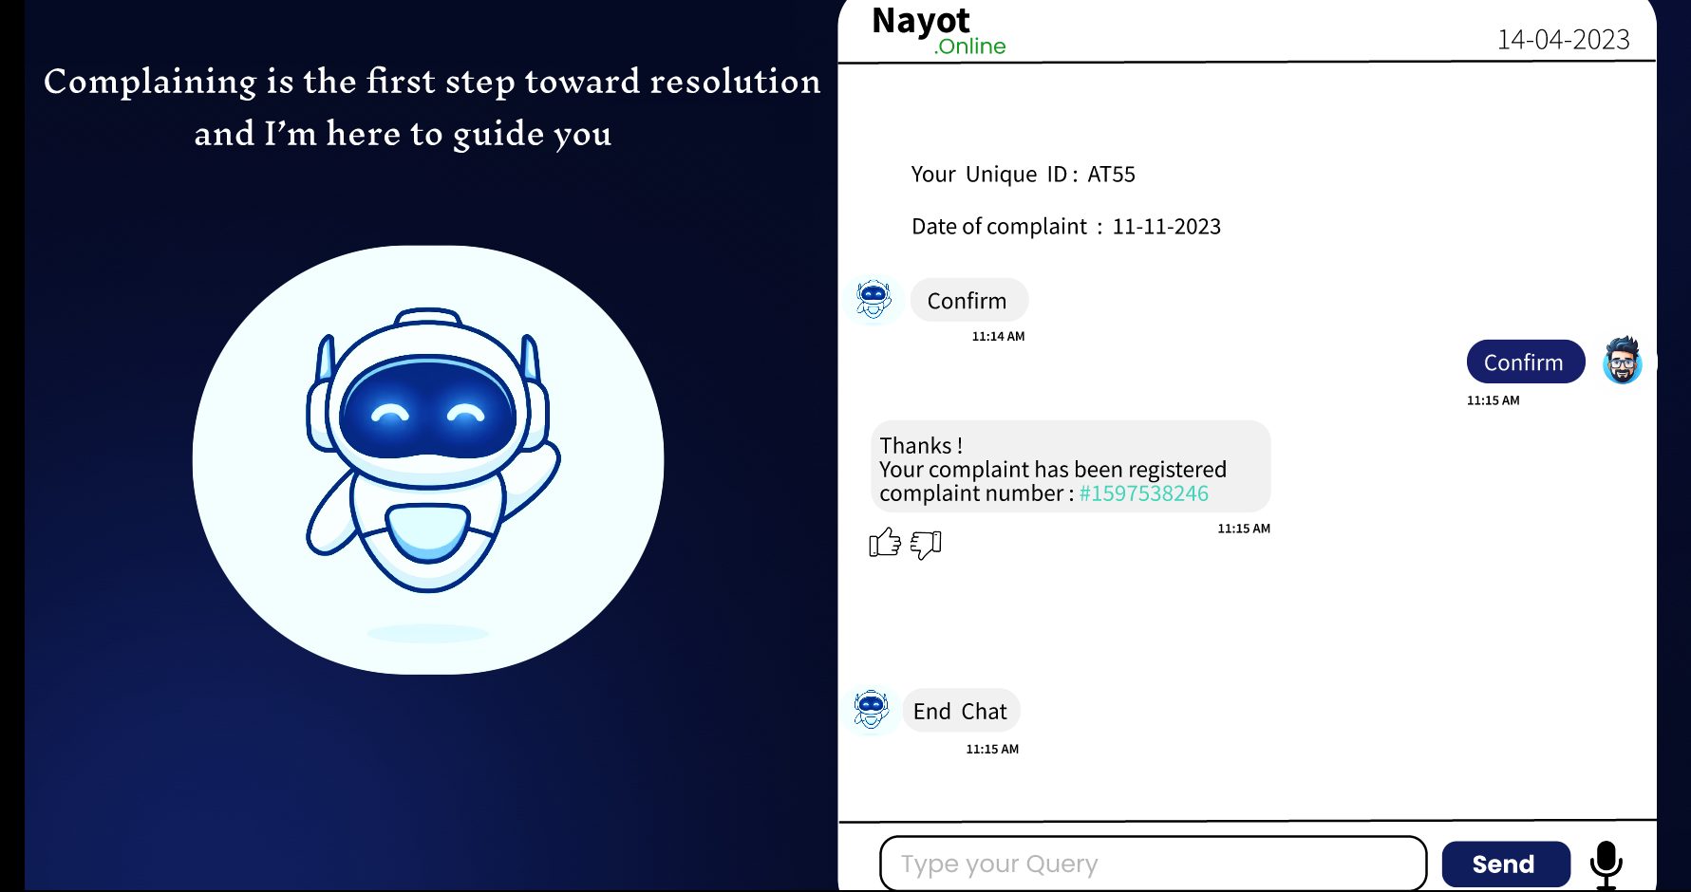
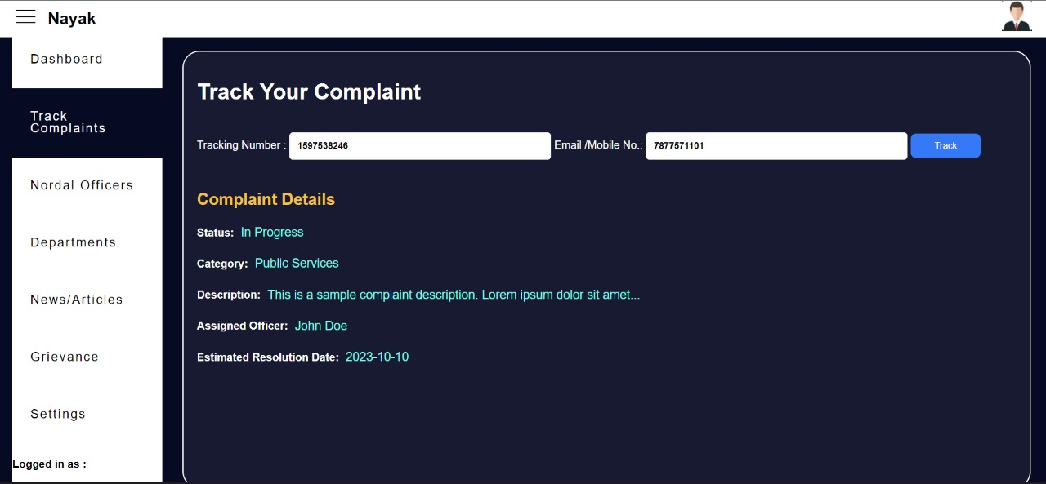
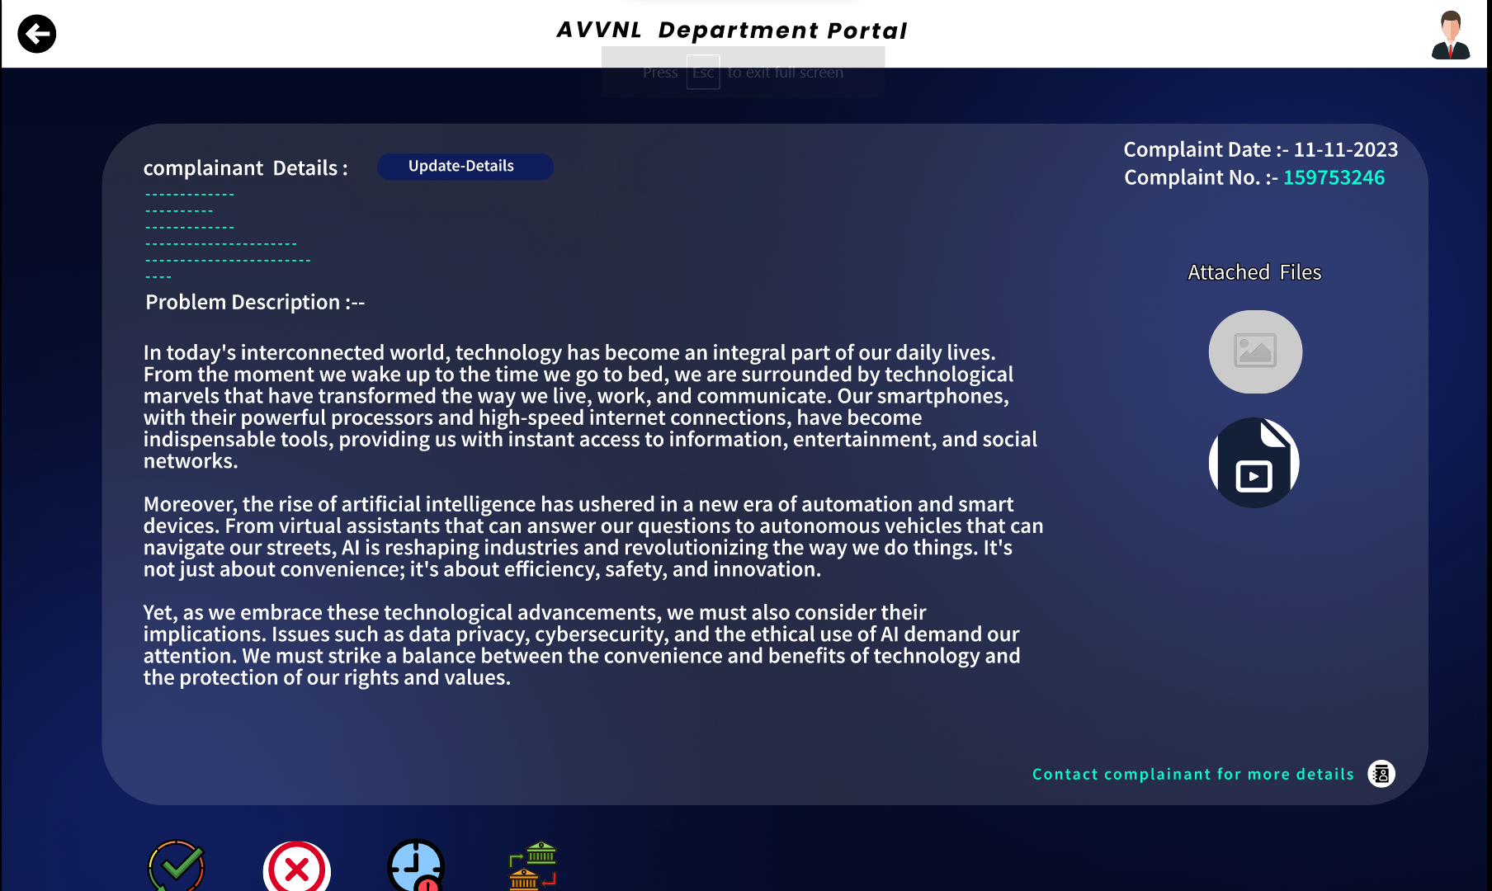
Web Application
User’s Portal
Department Portal

Slide 4
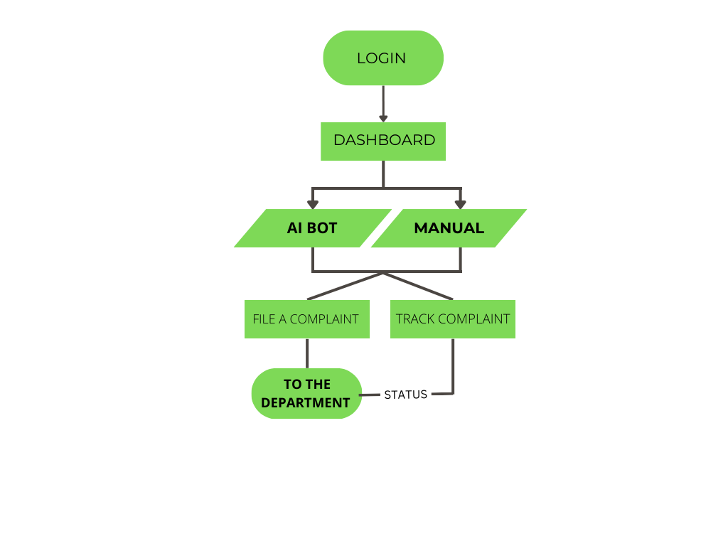
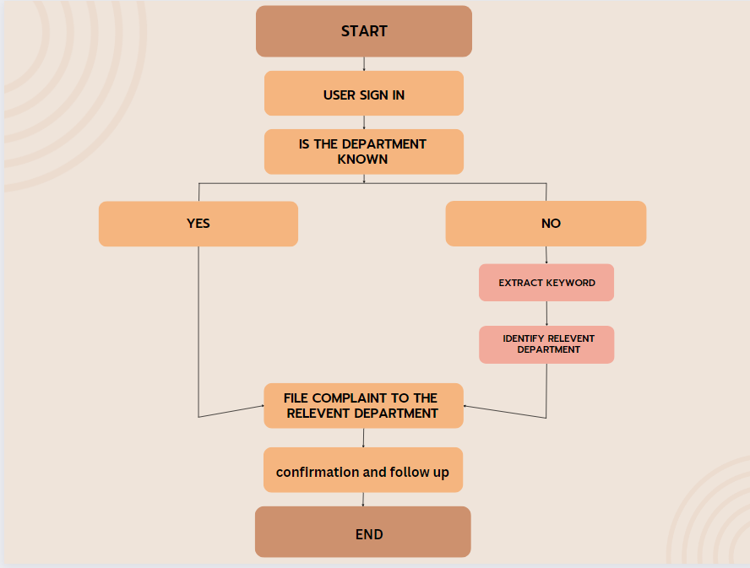






USE CASE:
DEPENDENCIES:
SHOWSTOPPERS :
Our standout feature - a multilingual AI-Bot that accepts voice inputs, simplifying complaint submissions.
Dedicated dashboards for each department streamline complaint management, minimizing confusion and optimizing efficiency..

Slide 5
Team Member Details
Team Leader Name: AADARSH SONI
Branch : BTECH Stream : CSE Year : II
TALENT JAIN
Branch : BTECH Stream : CSE Year : II
SIDDHARTH MENARIA
Branch : BTECH Stream : CSE Year : II
GAURAVI NEGI
Branch : BTECH Stream : CSE Year : II
SHACHI JAIN
Branch : BTECH Stream : CSE Year : II
MITALI PALIWAL
Branch : BTECH Stream : CSE Year : II

